Slide 1
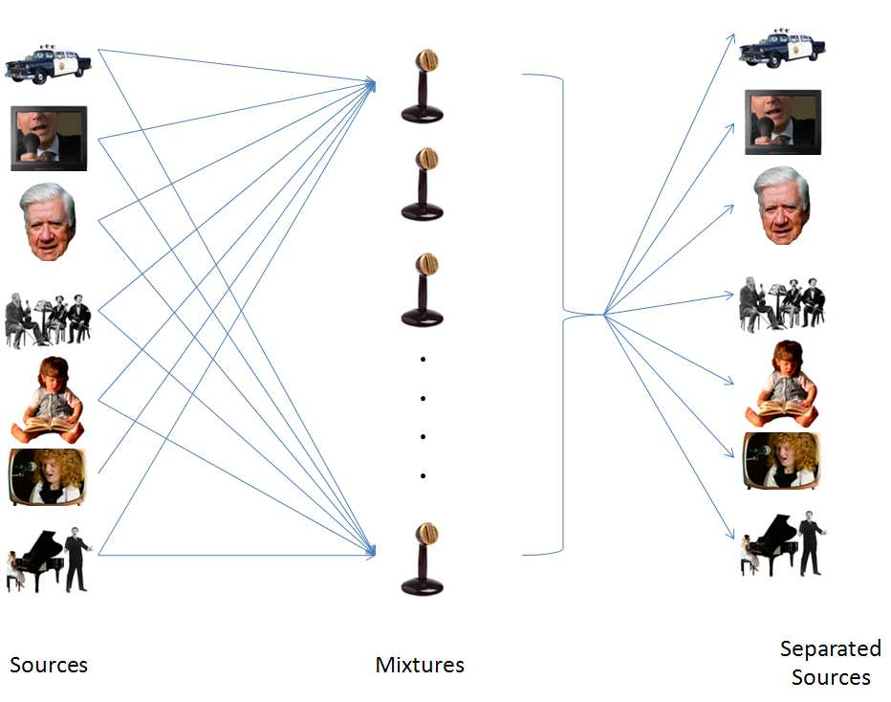
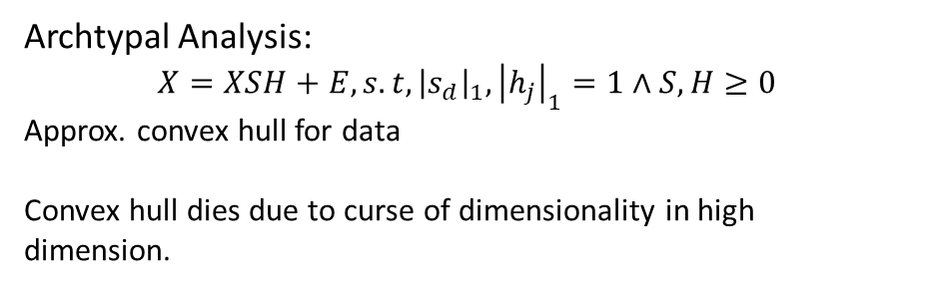
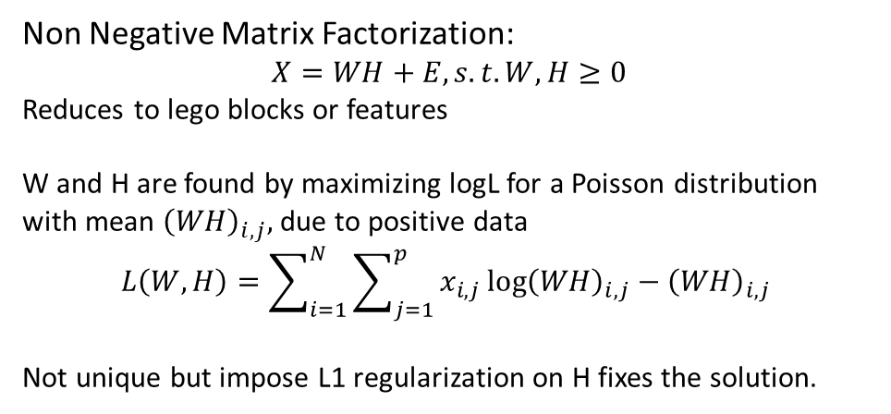
Lecture 10
Non Negative Matrix Factorization:
$$X=WH+E, s.t. W, H≥0$$
Reduces to lego blocks or features
W and H are found by maximizing logL for a Poisson distribution with mean ${\left(WH\right)}_{i,j},$due to positive data
$$L\left(W,H\right)=\sum_{i=1}^{N}{\sum_{j=1}^{p}{x_{i,j}\log{{\left(WH\right)}_{i,j}−{\left(WH\right)}_{i,j}} }}$$
Not unique but impose L1 regularization on H fixes the solution.
Ockham’s razor and unsupervised learning
Archtypal Analysis:
$$X=XSH+E, s.t, {\left|s_{d}\right|}_{1},{\left|h_{j}\right|}_{1}=1∧S,H≥0$$
Approx. convex hull for data
Convex hull dies due to curse of dimensionality in high dimension.
$$X≈AS=\left(AQ^{−1}\right)\left(QS\right)=\hat{A}\hat{S}$$
Notes:
Gini er konventionen til opbyggelse og miss class er til prune

Slide 2
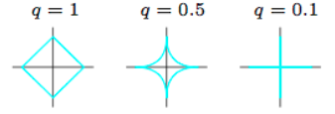
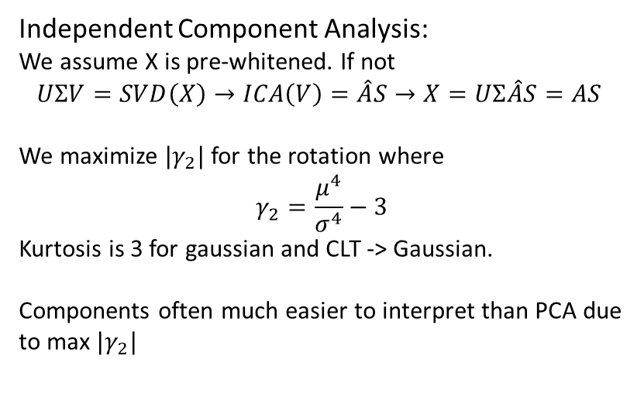
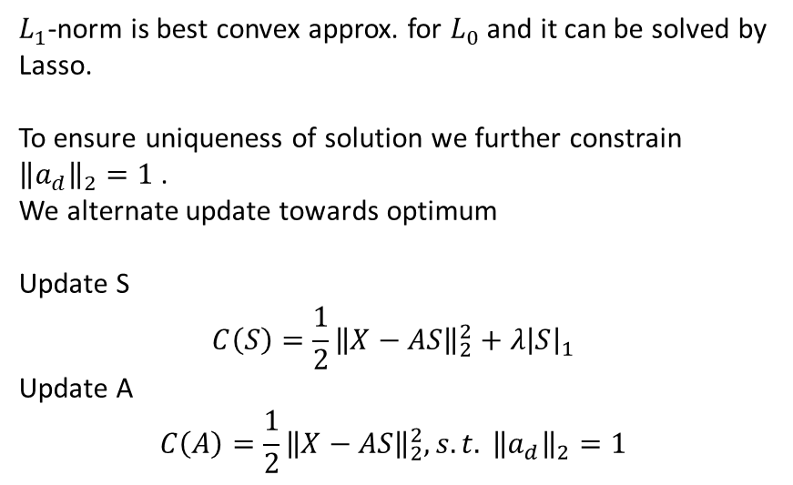
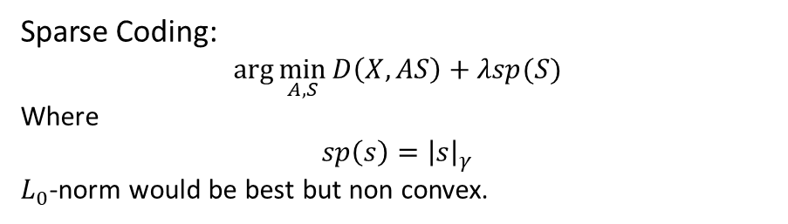
Lecture 10
Sparse Coding:
$$\arg{\min_{A,S}{D\left(X,AS\right)+λsp(S)}}$$
Where
$$sp\left(s\right)={\left|s\right|}_{γ}$$
$L_{0}$-norm would be best but non convex.
Independent Component Analysis:
We assume X is pre-whitened. If not
$$UΣV=SVD\left(X\right)→ICA\left(V\right)=\hat{A}S→X=UΣ\hat{A}S=AS$$
We maximize $|γ_{2}|$ for the rotation where
$$γ_{2}=\frac{μ^{4}}{σ^{4}}−3$$
Kurtosis is 3 for gaussian and CLT -> Gaussian.
Components often much easier to interpret than PCA due to max $|γ_{2}|$
$L_{1}$-norm is best convex approx. for $L_{0}$ and it can be solved by Lasso.
To ensure uniqueness of solution we further constrain
${\left\|a_{d}\right\|}_{2}=1$.
We alternate update towards optimum
Update S
$$C\left(S\right)=\frac{1}{2}{\left\|X−AS\right\|}_{2}^{2}+λ{\left|S\right|}_{1}$$
Update A
$$C\left(A\right)=\frac{1}{2}{\left\|X−AS\right\|}_{2}^{2}, s.t. {\left\|a_{d}\right\|}_{2}=1$$
Notes:
Gini er konventionen til opbyggelse og miss class er til prune

